Slide 1


Data Wrangling
Data gathering
Provided by:

Slide 2
Data Gathering approaches
Page
Subject
Predicate
RDF/XML

Slide 3
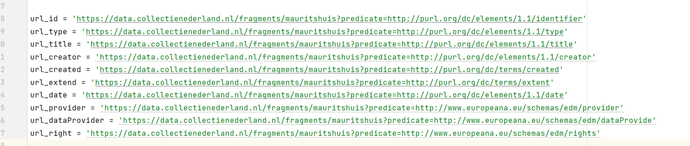
Page and Predicate approaches 1/2
Page approach: Each page separately collected by python
https://data.collectienederland.nl/fragments/mauritshuis?page=30
Predicate approach: Each predicate for data used in python code and data gathered by python

Slide 4
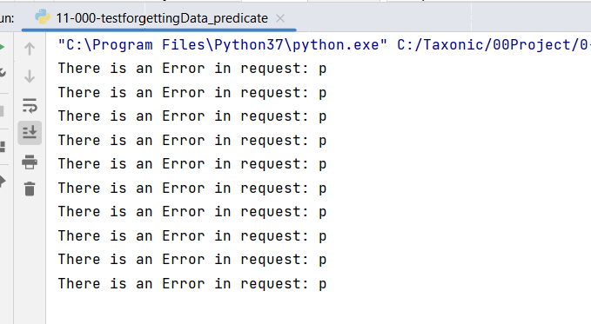
Page and predicate approaches 2/2
Data concatenation using Unix:
cat *.ttl > total.ttl
Result of both approaches:
incomplete data

Slide 5
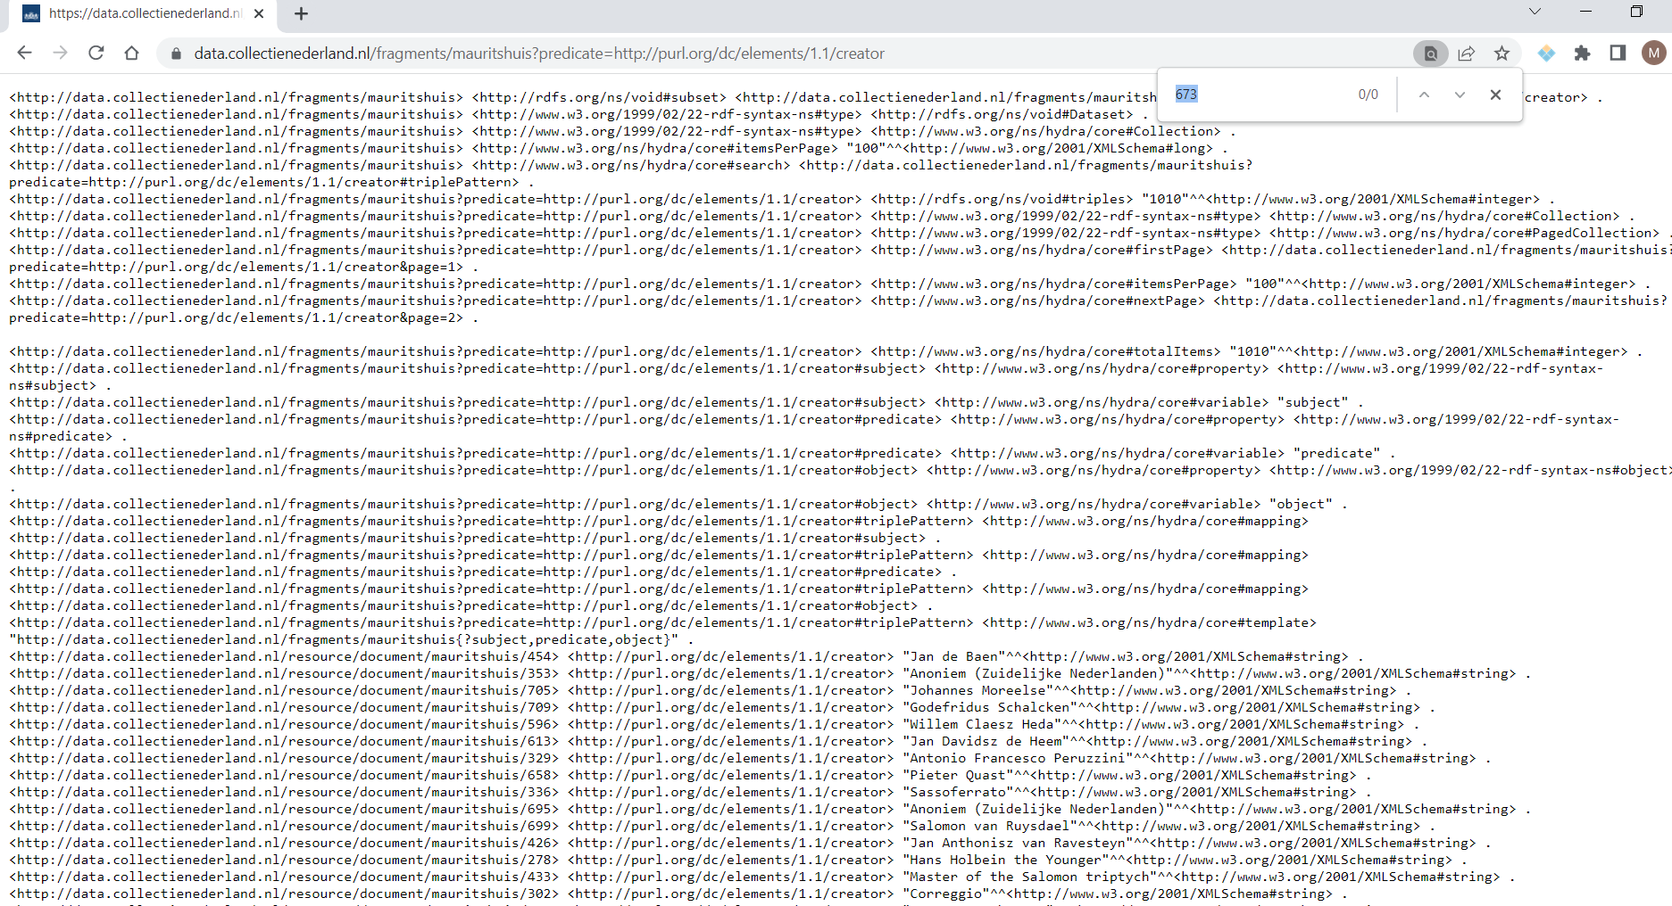
Page and predicate approaches 2/2 _creator
There is not 673 creator with general subjects search on API
Please try yourself using URL in the note.
Notes:
https://data.collectienederland.nl/fragments/mauritshuis?predicate=http://purl.org/dc/elements/1.1/creator

Slide 6
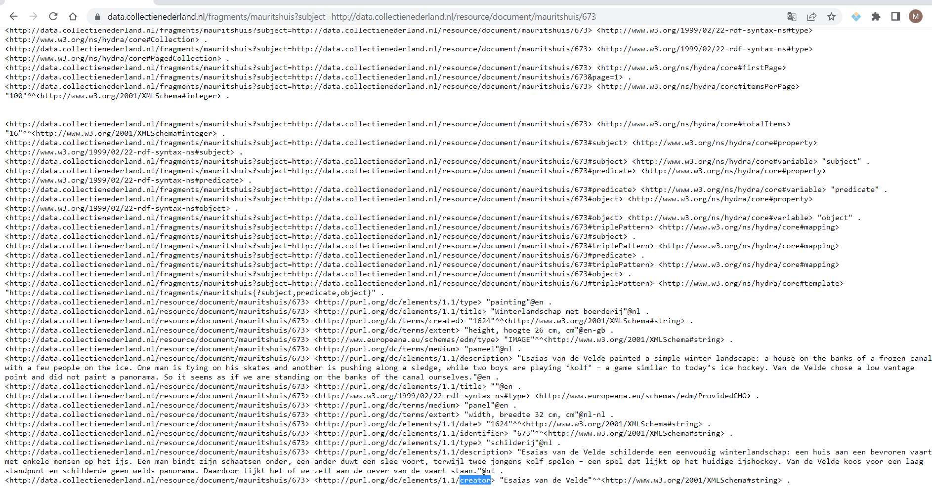
Page and predicate approaches 2/2 _creator
There is a 673 creator with the specific subject search on API
Please try yourself using URL in the note. There are also duplication in data
Notes:
https://data.collectienederland.nl/fragments/mauritshuis?subject=http://data.collectienederland.nl/resource/document/mauritshuis/673

Slide 7
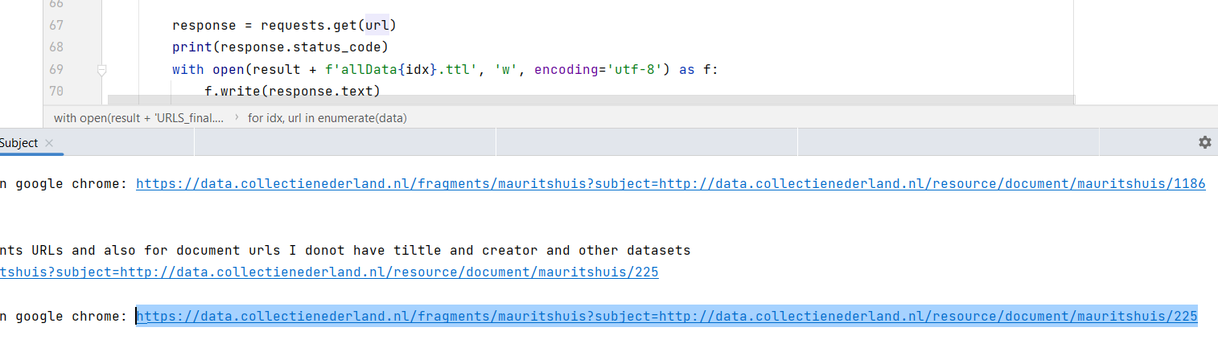
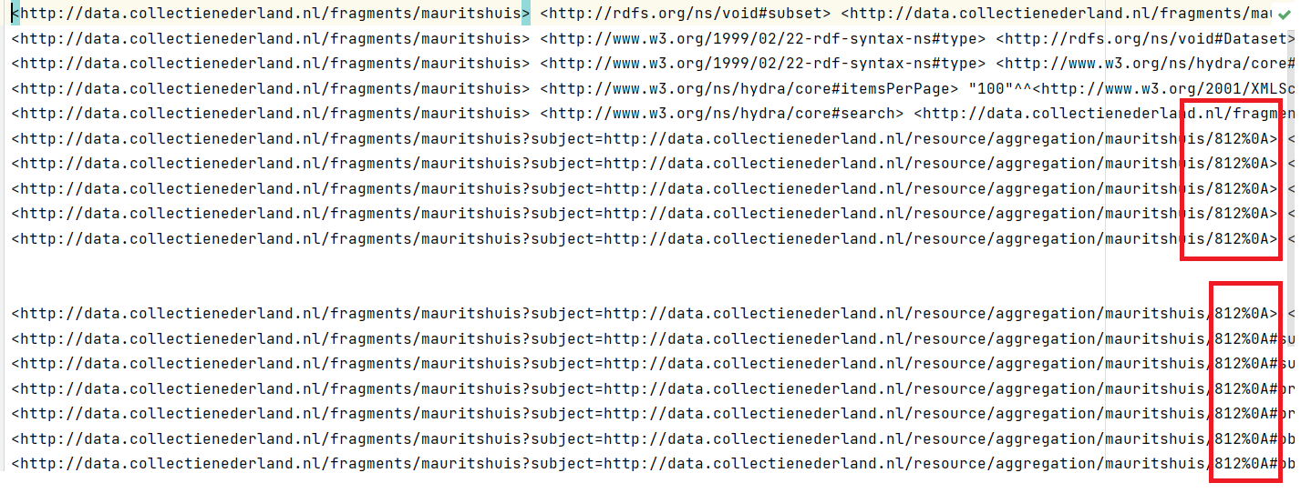
Subject
Using python, I only get the first part of metadata and control not data itself. Because some characters(e.g.,225%A) are added to request??!!
Python URLs used for request:
The output of requests
change in gather data:

Slide 8
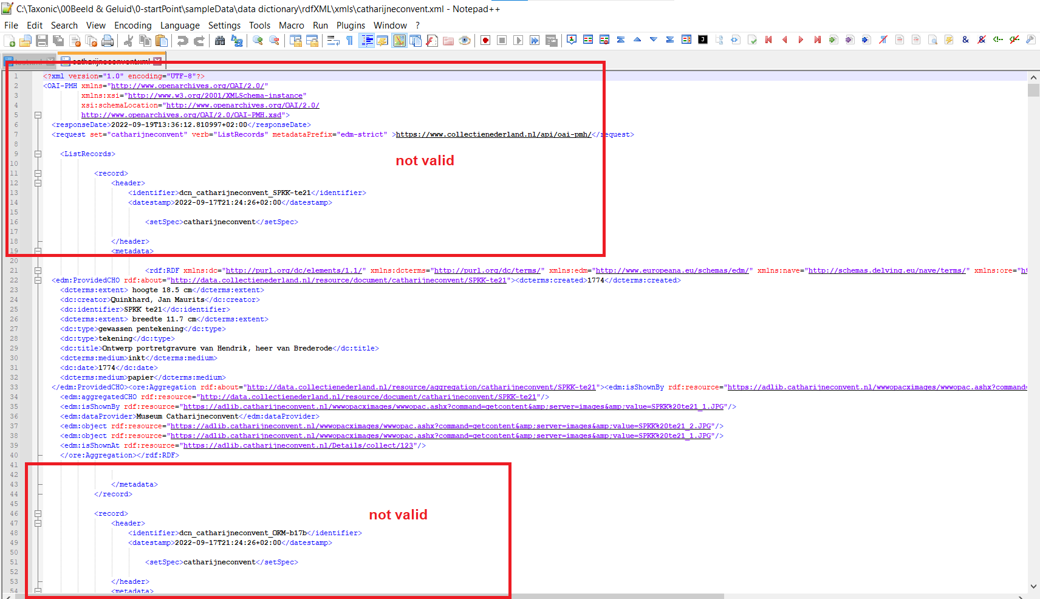
RDF/XML steps and problem 1/3
1)First isolating the rdf/xml

Slide 9

The next approach: Open to solutions ☺

